Slide 1


Slide 2
Today’s Agenda
Place of Supply.
Returns under GST.
Input Credit Rules.
Account Record Rules.
Composition Rules.
E-Way Bills
To Do List for Transition of GST.

Slide 3
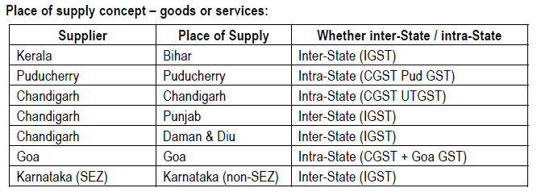
Place of Supply

Slide 4
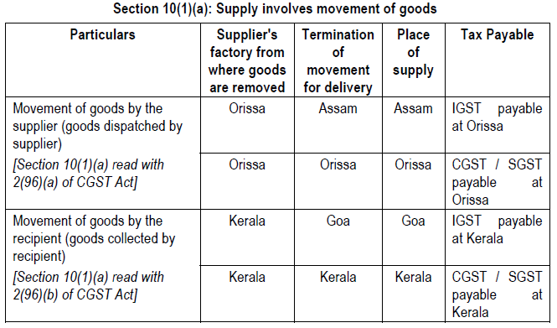
Place of Supply

Slide 5
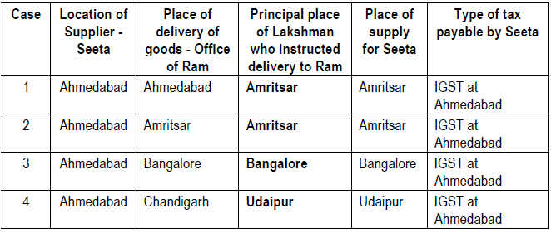
Place of Supply
Section 10(1)(b): Supply involves movement of goods, and delivered to a person on the instruction of a third person.

Slide 6
Place of Supply
Section 10(1)(b): Supply involves movement of goods, and delivered to a person on the instruction of a third person.

Slide 7
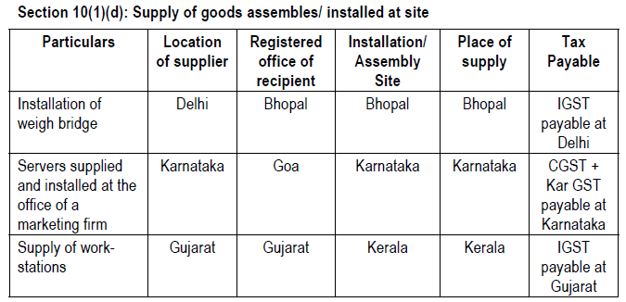
Place of Supply

Slide 8
Returns under GST
Return Form | What to File | By Whom | By When
GSTR-1 | Details of outward supplies of taxable goods / services effected | Reg. Taxable Supplier | 10th of next month
GSTR-2 | Details of inward supplies of taxable goods / services effected claiming input tax credit. | Registered Taxable Recipient | 15th of next month
GSTR-3 | Monthly return on the basis of finalization of details of outward supplies and inward supplies along with the payment of amount of tax. | Registered Taxable Person | 20th of next month
GSTR-4 | Quarterly return for compounding taxable person. | Composition Supplier | 18th of the month succeeding quarter

Slide 9
Returns under GST
Return Form | What to File | By Whom | By When
GSTR-5 | Return for Non-Resident foreign taxable person | Non-Resident Taxable Person | 20th of the next month
GSTR-6 | Return for Input Service Distributor | Input Service Distributor | 13th of the next month
GSTR-7 | Return for authorities deducting tax at source. (Contract > Rs 5 lacs) TDS rate proposed is 1% | Tax Deductor (receiver of goods / services) | 10th of next month
GSTR-8 | Details of supplies effected through e-commerce operator and the amount of tax collected | E-commerce Operator/Tax Collector | 10th of next month

Slide 10
Returns under GST
Return Form | What to File | By Whom | By When
GSTR-9 | Annual Return | Registered Taxable Person | 31st Dec of next financial year
GSTR-10 | Final Return | Taxable person whose registration has been surrendered or cancelled. | Within three months of the date of cancellation or date of cancellation order, whichever is later.
GSTR-11 | Details of inward supplies to be furnished by a person having UIN | Person having UIN and claiming refund | 28th of the month following the month for which statement is filed

Slide 11
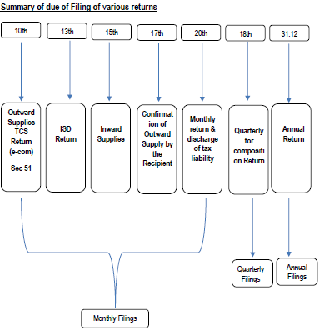
Returns under GST

Slide 12
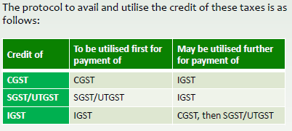
Input Credit Rules

Slide 13
Input Credit Rules
Conditions to Claim Input Credit:
Person possesses Invoice / Bill of Entry / Debit Note issued by Registered Supplier.
Supplier has paid Tax on the supply.
Person has received the goods or services.
In case goods are received in instalments, final shipment is received.
Input goods / service are used in the course or furtherance of business.

Slide 14
Input Credit Rules
Words in section 16 refer to registered taxable Person & not Entity.
Entity may have multiple GST registration and need to claim input credit accordingly.

Slide 15
Input Credit Rules
Apportionment of Input Credit:
Proportionate credit for input used Partly for business and partly for other activities.
2. In case of mixed supply – i.e. Taxable & exempt, then credit shall be restricted to so much of the input tax as is attributable to the said taxable supplies including zero-rated supplies.

Slide 16
Input Credit Rules
Input Credit NOT available:
motor vehicles and other conveyances.
2. food and beverages, outdoor catering, beauty treatment, health services, cosmetic and plastic surgery.
3. membership of a club, health and fitness centre
4. rent-a-cab, life insurance, health insurance with certain exception.
5. travel benefits extended to employees on vacation.

Slide 17
Account Record Rules
Every Registered person shall maintain true and correct account of goods or services exported / imported attracting payment of tax along with delivery bills, debit notes, e-way bills, refund vouchers.
Maintain separate account of tax collected, input credit availed, register of tax invoice.

Slide 18
Account Record Rules
3. Every registered person shall keep the particulars of -
(a) names and complete addresses of suppliers from whom he has received the goods or services chargeable to tax under the Act;
(b) names and complete addresses of the persons to whom he has supplied goods or services, where required under these rules;
(c) the complete address of the premises where goods are stored by him, including goods stored during transit along with the particulars of the stock stored therein

Slide 19
Account Record Rules
(8) Any entry in registers, accounts and documents shall not be erased, effaced or overwritten, and all incorrect entries, otherwise than those of clerical nature, shall be scored out under attestation and there after correct entry shall be recorded and where the registers and other documents are maintained electronically, a log of every entry edited or deleted shall be maintained.

Slide 20
Account Record Rules
(12) Every registered person manufacturing goods shall maintain monthly production accounts, showing quantitative details of raw materials or services used in the manufacture and quantitative details of the goods so manufactured including the waste and by products thereof.

Slide 21
Account Record Rules
(14) Every registered person executing works contract shall keep separate accounts for works contract showing -
(a) the names and addresses of the persons on whose behalf the works contract is executed.
(b) description, value and quantity (wherever applicable) of goods or services received for the execution of works contract.

Slide 22
Account Record Rules
(15) The records under these rules may be maintained in electronic form and the record so maintained shall be authenticated by means of a digital signature.
(18) Every registered person shall, on demand, produce the books of accounts which he is required to maintain under any law in force.

Slide 23
Composition Rules
Conditions section 10 of CGST Act
Person is not engaged in the supply of services except works contract u/s 2(119), supply of food (Schedule II, Para 6)
Engaged in making goods not leviable to tax
not engaged in making any inter-State outward supplies of goods.
4. not engaged in making any supply of goods through an electronic commerce operator

Slide 24
Composition Rules
Provided that where more than one registered persons are having the same Permanent Account Number (issued under the Income-tax Act, 1961), the registered person shall not be eligible to opt for the scheme under sub-section (1) unless all such registered persons opt to pay tax under that sub-section.
A taxable person to whom the provisions of sub-section (1) apply shall not collect any tax from the recipient on supplies made by him nor shall he be entitled to any credit of input tax.

Slide 25
Composition Rules
Rates under Composition
Particulars | SGST | CGST
Manufacturers, other than manufacturers of such goods as may be notified by the Government | 1% | 1%
Suppliers making supplies referred to in clause (b) of paragraph 6 of Schedule II | 2.5% | 2.5%
Any other supplier eligible for composition levy under section 10 and these rules | 0.5% | 0.5%

Slide 26
E-Way Bills
Every registered person who causes movement of goods
in relation to a supply
for reasons other than supply
due to inward supply from an unregistered person
shall, before commencement of movement, furnish information relating to the said goods

Slide 27
E-Way Bills
Any transporter transferring goods from one conveyance to another in the course of transit shall, before such transfer and further movement of goods, generate a new e-way bill on the common portal.
In case of multiple consignments, generate consolidated EBN
EBN shall be valid upto certain period.

Slide 28
E-Way Bills
The recipient shall communicate his acceptance on the common portal, else after 72 hours of scheduled time it shall be deemed as accepted.

Slide 29
To Do List for Transition to GST
Take Physical Stock of Goods on 31-3-2017 & 30-6-2017.
File your last Excise / VAT returns carefully to claim input tax credit under New Law.
Check your P & L for supplies covered under Reverse Charge.
Prepare GST Master Data. Rule 5 of Accounts & Records.

Slide 30


